Slide 1
IBM University Engagement Project Submission
“Exploring the Power of Agentic AI with IBM Granite and LangFlow”

Slide 2
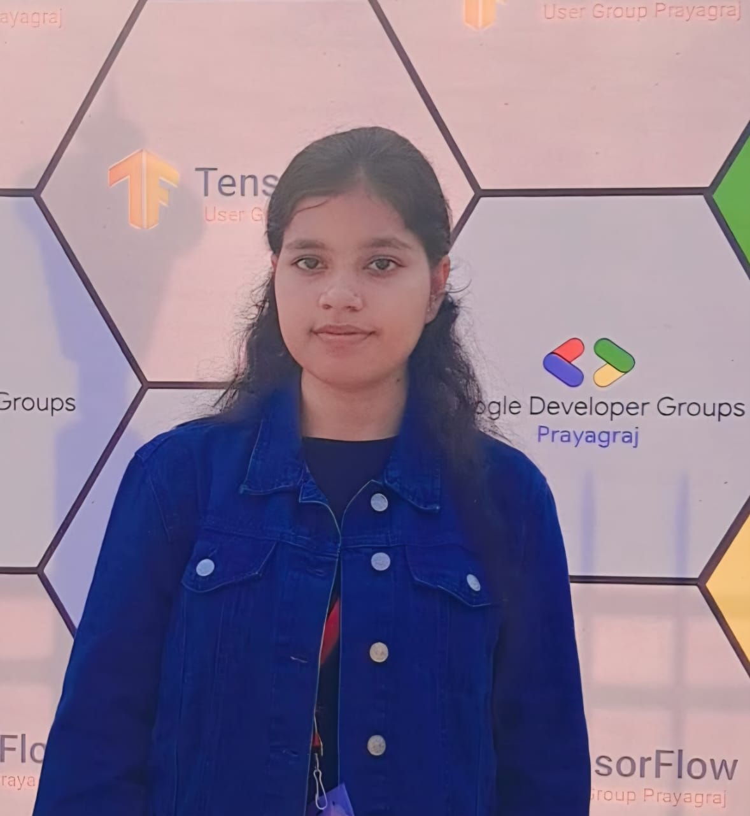
Project Title – [Interview Trainer Agent – “PrepPilot AI” #22 ]
Domain of Project – [ Education ]
Student Name | Recent Passport Photo | Email ID | Mobile number [WhatsApp]
Ayushi Srivastava |  | ayushisrivastava542@gmail.com | 9236868023

Slide 3
Problem Statement -
Problem Statement No. 22 – Interview Trainer Agent
The Challenge
Preparing for job interviews is difficult because candidates often lack access to role-specific interview questions, personalized feedback, and realistic interview simulations. Existing resources are generic and fail to adapt to individual experience levels, resumes, and job roles.
The Interview Trainer Agent uses Retrieval-Augmented Generation (RAG) and IBM Granite Models to provide personalized interview preparation by retrieving relevant technical questions, HR scenarios, company interview experiences, and industry expectations from trusted knowledge sources.
The Objective
Develop an AI-powered Interview Trainer that:
Conducts HR and technical mock interviews
Generates personalized interview questions
Evaluates user responses
Provides detailed AI feedback
Identifies strengths and weaknesses
Suggests improvement plans
Tracks interview performance over time

Slide 4
Proposed Solution -
Proposed Solution: PrepPilot AI is an intelligent Interview Trainer Agent developed using React, Spring Boot, PostgreSQL, IBM watsonx.ai, IBM Granite Models, and IBM Cloud Lite Services.
The platform analyzes the user's profile, experience level, resume, and selected job role to generate customized interview questions. Using AI-powered reasoning and Retrieval-Augmented Generation (RAG), it provides accurate answers, evaluates user responses, identifies improvement areas, and recommends personalized preparation strategies.
The application supports both technical and behavioral interviews while maintaining interview history and progress reports.

Slide 5
Technology Used-
Artificial Intelligence
IBM watsonx.ai
IBM Granite Models
Retrieval-Augmented Generation (RAG)
Cloud
IBM Cloud Lite Services
Development Tools
Maven
Git
GitHub
VS Code
Frontend
React.js
Bootstrap
Axios
Backend
Java 21
Spring Boot
Spring Security (JWT)
REST APIs
Database
PostgreSQL

Slide 6
Langflow component Used -
1. Chat Input: Collects user inputs such as job role, experience level, resume details, and interview preferences.
2. Prompt Template:Creates structured prompts for generating personalized interview questions and evaluation criteria.
3. IBM watsonx.ai Model: Connects to IBM Granite Models to generate interview questions, model answers, and AI-driven feedback.
4. RAG Component (Retriever): Retrieves relevant interview questions, HR scenarios, and industry-specific information from the knowledge base before sending the context to the AI model.
5. Chat Output: Displays interview questions, AI responses, feedback, interview scores, and improvement suggestions.
6. Memory Component: Maintains conversation context across multiple interview questions to simulate a realistic interview session.

Slide 7

Role of Agentic AI in the solution
Role of Agentic AI:
PrepPilot AI uses Agentic AI to simulate an intelligent interviewer capable of understanding context and adapting interview questions based on user responses.
The AI agent:
Reads resume information
Understands job role
Retrieves relevant interview knowledge using RAG
Generates personalized interview questions
Evaluates answers
Suggests improvements
Tracks learning progress
This creates an interactive and personalized interview preparation experience.

Slide 8
Novelty and Uniqueness
Novel Features
AI-powered Interview Simulation
Resume-aware Question Generation
Role-specific Interview Preparation
RAG-based Knowledge Retrieval
Technical & HR Interviews
Personalized Feedback
Progress Tracking
Secure Spring Boot Architecture
IBM Granite AI Integration
Uniqueness
Unlike traditional interview preparation platforms, PrepPilot AI dynamically adapts to the user's profile and provides contextual guidance.

Slide 9
Git Hub Link-
https://github.com/ayushi826/Interview-Trainer-Agent-PrepPilot-AI-.git
·
·
·

Slide 10
Future Scope
Voice Interview Simulation
Video Interview Analysis
Facial Expression Recognition
ATS Resume Analyzer
Coding Interview Module
Company-specific Interview Sets
AI Career Mentor
Mobile Application
Multilingual Interview Support
·
·
·

Slide 11
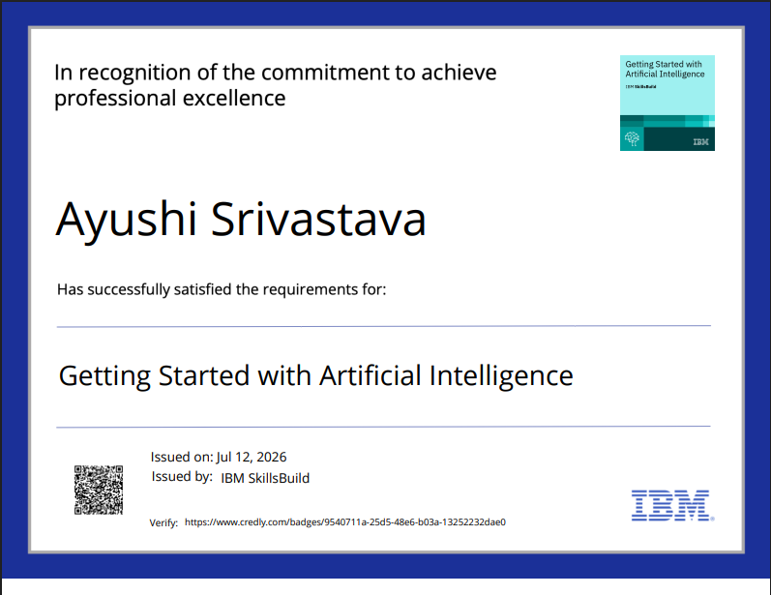
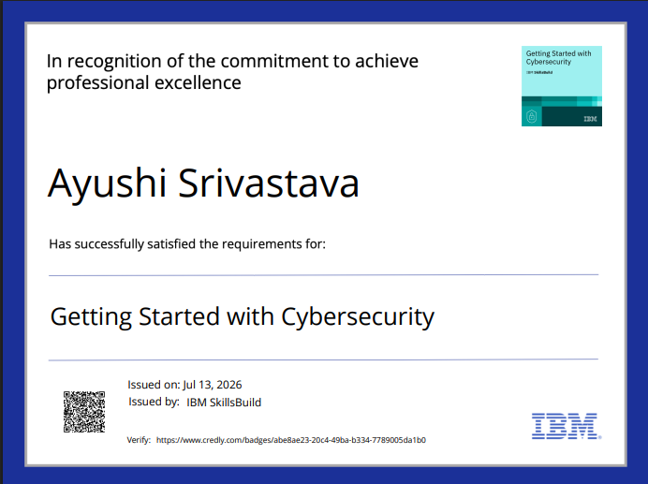
Credly Certificates Earned:

Slide 12
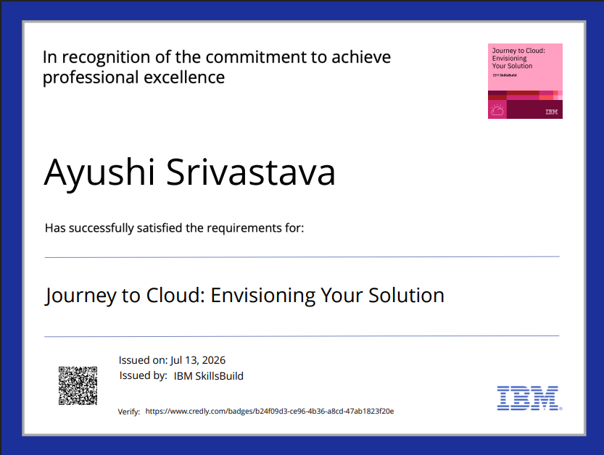
Certificates Earned:

Slide 13
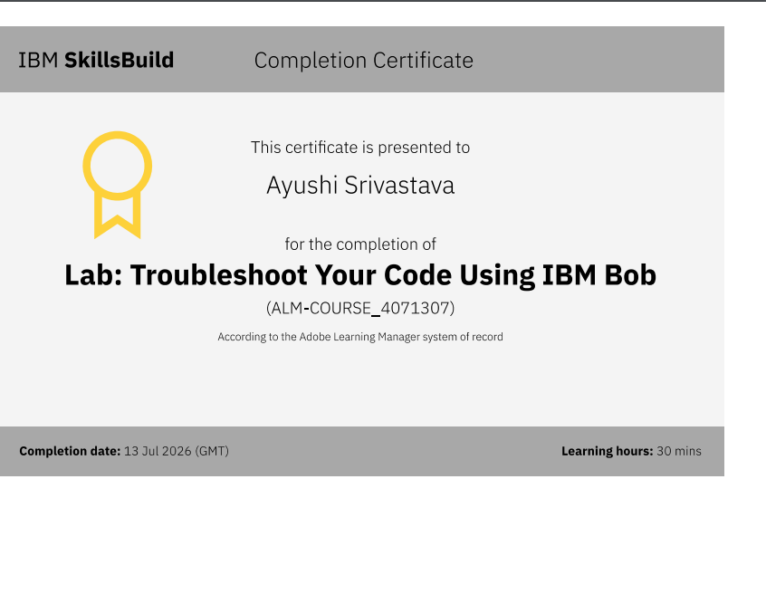
Certificates Earned:​
Add your IBM BOB Certificate

Slide 14


